Slide 1
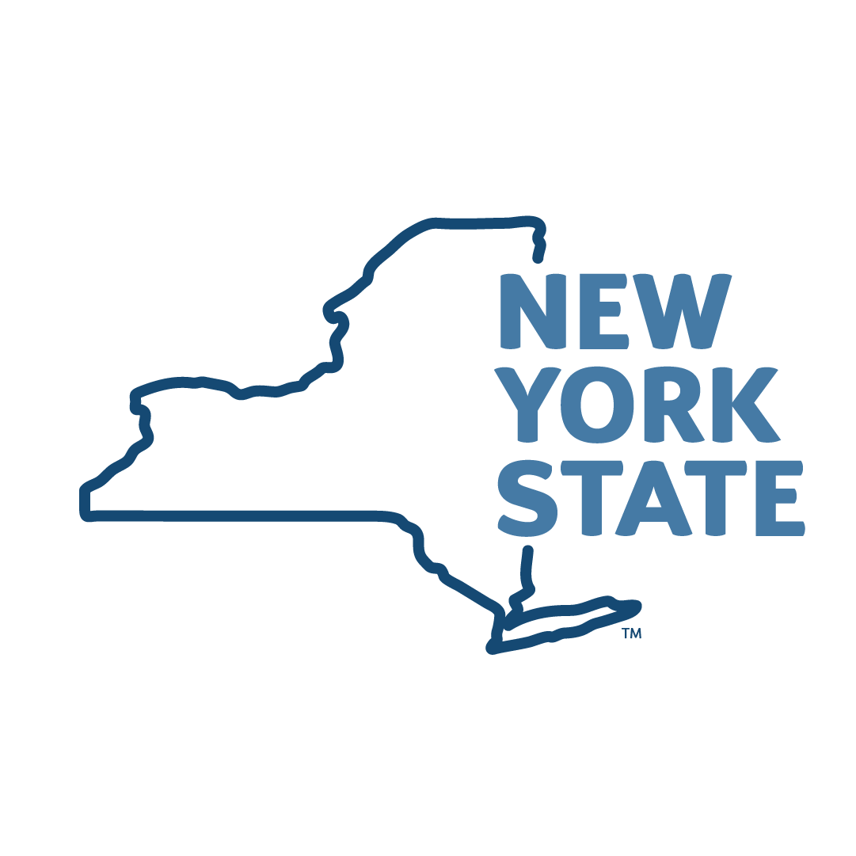
PUBLIC SERVICE LOAN FORGIVENESS PROGRAM
As a New York State Employee, You May Be Eligible to Have Student Loans Forgiven through this Federal Program
CONTACT: Nicole bacon-ward, 315-267-2090, & baconwns@potsdam.edu
Additional information
MORE INFO: oer.ny.gov/public-service-loan-forgiveness
Notes:
Cover Slide (option 3)

