Slide 1
Office of Accommodative Services Helpful Tips
Jessica Burnett
Assistant Director of SSC, Office of Accommodative Services

Slide 2
Leveling the Playing Field Equal Access

Slide 3
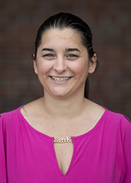
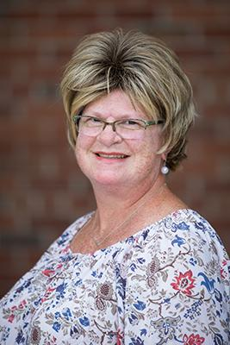
Office of Accommodative Services Team
Jessica Burnett
OAS Coordinator
Sisson Hall-Room 111
Patricia Gilmer
Office Assistant
Sisson Hall-Room 110

Slide 4
Top 6 Things to Know About OAS
Our office serves approximately 250 students with documentation disabilities with their classroom accommodations. Disabilities include temporary disabilities (concussions, broken wrist or hand), learning disabilities (ADHD, dyslexia, math and reading disabilities, other health impairments such as diabetes, traumatic brain injuries, narcolepsy, hearing impairments, mood disorders, and anxiety) just to name a few.
We also work with students who request special needs housing, emotional support animals and service animals. To be part of accommodative services students must self-identify with our office. This can happen at any point throughout the semester or academic career.
Each student’s accommodation plan is unique and different, so talking with students about their accommodations are essential to developing a great rapport with them. In order for students to receive testing/classroom accommodations they must submit a request form online in order to activate their accommodation plan for the semester. Once a students accommodation plan is emailed to faculty we encourage them to have a conversation with you regarding their accommodations and how they will use their accommodations in your class.
Following student accommodation plans is the law and you must abide by the accommodations written in a student’s plan. If the accommodation alters the essential foundation of the class, please contact us.

Slide 5
Things to Know About OAS continued
5. If you have a student who you think may benefit from our services, please let us know how we can assist with guiding you on how to make the referral to our office.
6. All exam scheduling forms are now 100% online. A student will fill out the form online and you will receive an email- Please complete your section of the email Faculty Exam Proctoring Form.
Please fill out the Faculty Exam Proctoring Form with the required information and send forms 24 Hours in advance as we need to time to prepare the exam rooms and upload the software needed for our students to take their exams.
For your convenience you can attach your tests directly into the exam request.
If you need to email your test please email it to OAS@potsdam.edu
Thank you- we appreciate your efforts to communicate with us regularly. We are here to assist you and students with any questions you may have.
Our location is 111 Sisson Hall and our hours are Monday-Friday 8-4:00 pm. OAS@potsdam.edu – (315)-267-3267

Slide 6
Syllabus Statement
Student Accessibility Services:
The Office of Accommodative Services website has examples of accommodative services syllabus statements you may choose to include in your syllabus. Feel free to sightly change your syllabus statement to met your teaching style.
One example:
If you are a student with a disability and wish to discuss reasonable accommodations for this course, contact me privately to discuss the specific modifications you wish to request. If you have not yet contacted Accommodative Services, located in Sisson Hall room 111, please do so in order to verify your disability and to coordinate your reasonable modifications. For more information, visit the Accommodative Services website.
The syllabus is an official presentation of your specific course each semester beyond the course description included in the college catalog your syllabus shows you are adhering to the policies and best practices of SUNY. It contains class information, homework, dates of tests, and reading assignments. Having an inclusive and accessible syllabus shows intend to enable all your students to fully utilize your materials and all additional supports SUNY Potsdam has to offer .
"The failure of the adaptation of the material to needs and capacities of individuals may cause an experience to be non-educative quite as much as a failure for an individual to adapt(him/her) self to the material"- John Dewey.

Slide 7
What To Do If You Suspect a Student Has a Specific Learning Style and or Medical Condition
Recommendations for connecting a student to OAS for services:
This may require some teamwork with you and the OAS office. Feel free to email or call me at (315) 267-3267 (Office) or email burnetjj@potsdam.edu this way we can discuss how you can eloquently approach your student(s) in question without seeming interrogative or scaring the student away with working with our office. The common goal is to assist and make the process seamless for the student.
Example of an email:
To: Student Email
CC: Jessica Burnett
Subject: Office of Accommodative Services
After our conversation today, I wanted to follow up by connecting you with the Coordinator of the Office of Accommodative Services, Jessica Burnett. The OAS office will be able to meet with you to discuss how they may be a resource to you at Potsdam. You can reach out to them via email at OAS@potsdam.edu, Call them at (315) 267-3267, or stop by Sisson 111.

Slide 8
What if a student does not have a documented disability?
If you are working with a student who does not have documentation of a disability and does not, or can not, get tested for a disability, consider sharing a few of these resources and/or adding them to your course in Moodle for all students to explore.
Reading | Spelling/ Grammar / Writing | Notetaking | Time Management
Vitalsource Bookshelf – Textbook with built in read aloud feature | Grammarly- checks for writing, spelling and grammar errors | AudioNote- Designed for iPad – Search recording for keywords | Block Site- website blocker
Bookshare – Can customize experience to suite learning style | Voice in Voice Typing- Type in any text box on any website by speaking | Evernote- Syncs notes across all devices. | Remember the Milk – Tasks/ to-do- list
Readme -Reading websites, PDFs, and word documents | Hemingway- Helps make writing clear | Otter.ai – Provides real time transcripts that are downloadable | Google Keep – Reminders and task lists
VoiceDream – for apple – Reading websites, PDFS, and documents | Dictate- Voice to type |  | Notion –Tracking of daily tasks

Slide 9
A few difference between high school and college accommodations for additional examples visit the Office of Accommodative Services website
High School | College
Fundamental modifications of program and curricula are required | No fundamental modifications are required- only academic adjustments
The course load consists of reading short assignments that are discussed and often re-taught in class | The course load may require substantial amounts of reading and reading which may not be directly addressed in class
Tests are often modified or shortened | Students are expected to take the same test as all students
Shortened or modified assignments are given | Students are expected to do that same work as all students
Students are scheduled to see resource personnel on a regular basis or can go to the resource room on a drop- in basis | Students must initiate requests for services. Student may submit documentation or request services at any point during the semester, but any grades already in place will not be changed
Special educators inform instructors about a student’s accommodation needs | Students need to speak with instructors about their accommodation plan every semester

Slide 10
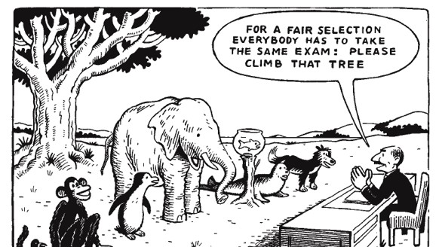
Testing Accommodations

Slide 11
Common Testing Accommodations
Extended Time 1.5 or 2.0
Separate Testing Location
Test Reader (Computer Software)
Computer for Typing
Scribe
Calculator

Slide 12
Strive for “beyond compliance”
Many students who have been previously identified as having a disability do not access accommodations once enrolled in higher education. The root of many common barriers lies in the makeup of the class.
Universal Design can reduce the need for classroom accommodations that often stigmatize students as receiving special treatment. Universal Design encourages the development of learning environments that do not depend on students disclosing aspects of their identity and needs to have equal access.
Tests:
Use Moodle
Place short weekly quizzes on Moodle before a class. This allows students who need extended time or a separate testing location to utilize what they need without missing any parts of the class or feeling like they are holding the rest of the class up.
Allow for multiple tries on quizzes and/or drop the lowest test grade
Develop different methods of assignments for the same assignment. For example: papers, presentations, verbal assessments, videos.
Allow untimed tests
*** If you have students who requires extended time on tests such as 1.5 times and you give the whole class the extended time, the student with the extended time would still require 1.5 times on top of the new time. Giving blanket extended time to everyone is not considered an appropriate accommodation ****

Slide 13
Strive for “beyond compliance” continued
Classroom Bans:
Classroom laptop bans can single out students who exercise their accommodation of using a laptop. These bands send the ableist message that the course is designed for some students- those who succeed by handwriting their notes.
For accommodation notetaker:
Include a class wide assignment which students sign up to take notes on a different day in the semester or ask for volunteers. All notes are made available to everyone in the class. Or use a system that allows collaborative notetaking to happen at the same time during class- such as Google Docs. Make PowerPoints available before lectures to allow students to follow along.
For accommodation extended deadlines on assignments:
Revise the statement in the syllabus regarding deadlines to indicated that deadlines are flexible for all students. To ensure accountability while providing flexibility, ask students to communicate with the professor before an assignment’s due date regarding extending the deadline.
For accommodation use of laptop for note taking:
Revise the statement in the syllabus regarding laptop computers to indicated that laptops and other forms of technology are allowed, as needed, for all students.
For accommodation recorded lecture:
Record your lectures either via audio only or video/audio and have lectures available for students to watch/read/listen to on the LMS. Or encourage students to use there own recording devices.
Disability Compliance for Higher Education/Vol 26 Issue 8 p 6-7

Slide 14
What can I do besides these listed accommodations?
When meeting with a student about their accommodation plan consider asking students “what can I do besides these listed accommodations?”
This question opens the lines of communication and can make your student feel more comfortable in your class. Students might talk about things that worked in high school or something that they have wanted to try.
If a student does not have any suggestions perhaps offer things like mid-semester check ins or encourage the use of office hours.
If a student suggests something that you think is an alteration to the class, please feel free to contact the Office of Accommodative Services to discuss the alternation. Slide 9 of this PowerPoint explains some differences between high school and college accommodations.

Slide 15
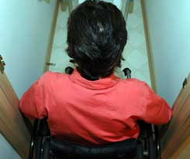
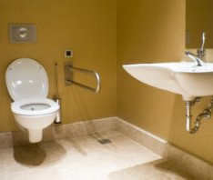
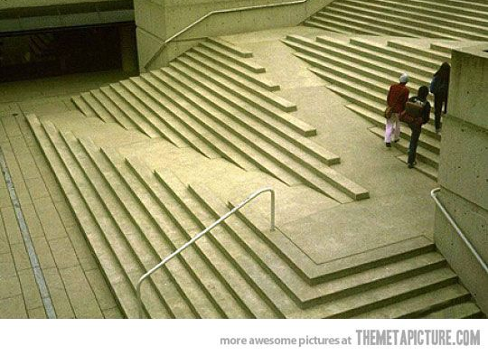
Design with accessibility in mind from the start. When creating materials, finding textbooks, videos, software, etc. It is easier to create/find accessible materials then it is to modify something that is already created.

Slide 16
Service Animals

Slide 17
What is a Service Animal?
A service animal is a dog that is individually trained to do work or perform tasks for a person with a disability.
How “Service Animal” Is Defined
Service animals are defined as dogs that are individually trained to do work or perform tasks for people with disabilities. Examples of such work or tasks include guiding people who are blind, alerting people who are deaf, pulling a wheelchair, alerting and protecting a person who is having a seizure, reminding a person with mental illness to take prescribed medications, calming a person with Post Traumatic Stress Disorder (PTSD) during an anxiety attack, or performing other duties. Service animals are working animals, not pets. The work or task a dog has been trained to provide must be directly related to the person’s disability.
Dogs whose sole function is to provide comfort or emotional support do not qualify as service animals under the ADA.

Slide 18
Service Animal Policy
Students do not need to register a service animal with the OAS office. For that reason, we may not know that a student has one.
Disability Compliance for Higher Education/April 2021
Students with a service animal do need to follow certain rules:
For an individual to qualify to have a service animal on campus:
He or she must have a disability as defined by the ADA.
The work or task a dog has been trained to provide must be directly related to the person's disability
The owner of the service animal is responsible:
To be in full control of the service animal at all times.
For all costs of the care and feeding of the service animal.
For removal of the animal's waste.
For compliance with local dog control and licensing regulations and laws, including vaccinations and wearing of tags.
There is a difference between service and assistance animals (emotional support animals).

Slide 19
Where are service animals allowed?
Where Service Animals Are Allowed?
Under the ADA, State and local governments, businesses, and nonprofit organizations that serve the public generally must allow service animals to accompany people with disabilities in all areas of the facility where the public is allowed to go.
For example, in a hospital it usually would be inappropriate to exclude a service animal from areas such as patient rooms, clinics, cafeterias, or examination rooms. However, it may be appropriate to exclude a service animal from operating rooms or burn units where the animal’s presence may compromise a sterile environment.

Slide 20
Controlling a Service Animals
Service Animals Must Be Under Control
Under the ADA, service animals must be harnessed, leashed, or tethered, unless these devices interfere with the service animal’s work or the individual’s disability prevents using these devices. In that case, the individual must maintain control of the animal through voice, signal, or other effective controls.

Slide 21
Touching Service Animals
Please note that under no circumstances should you be asking or interfering with the working task of the Service Animal. Doing so jeopardizes the working task of the Service Animal and puts the handler in distress because the dog is being distracted from doing its working task.
Please do not come up to touch the Service Animal or ask the handler to pet their Service Animal this is not permissible at all.
Thank you in advance for respecting Service Animals and their handlers that are a part of our campus community.
For more information regarding service animals visit the
Policies and Producer Page on the Office of Accommodative Services Website

Slide 22
Deaf and Hard of Hearing
INTERACTING WITH DEAF STUDENTS
When communicating with a deaf student, please look directly at them and address the student even if the interaction involves an interpreter or speech-to-text provider. Some hard of hearing students also read lips so facing students when you talk to them is always good practice. Defer to the student about academic-related questions or student progress in your course. Interpreters and speech-to-text providers are there to provide communication access in the classroom environment only. We recommend checking in with the student after the first couple of classes to ensure the accommodations set-up is effective for your classroom.
CREATING AN ACCESSIBLE LEARNING ENVIRONMENT
Sign language interpreters and speech-to-text providers are essential components of communication access in a classroom. Although there are some strategies that are unique to each profession, the guidelines listed below can promote effective communication, no matter what service is provided.
Remember to communicate directly with the deaf/hard of hearing student.
Brief but frequent pauses while using visual aids and demonstration are appreciated.
It always helps to write general class announcements on the board to make sure all involved are aware of the change.
Writing new vocabulary words on the board or overhead or sharing notes prior to the class is helpful.
Make sure all video materials are captioned and if using Zoom the captioning feature is turned on or if needed you allow the 3rd party captioner into the Zoom room.
If you have audio only files, a transcript must be provided in additional to the audio file.

Slide 23
Closed Captioning Materials
Captioning makes audio and video content more accessible. All videos that are uploaded to the internet including Moodle need to be captioned. The campus supports a self-service model for captioning. This means that faculty are responsible for captioning their own teaching-related video content.
To view the resources that are available to you for captioning visit the Office of Accommodative Services Captioning section located on the Faculty section of the website.

Slide 24
Questions
If you have any questions, please feel free to contact me:
Jessica Burnett, Assistant Director of SSC, Office of Accommodative Services
burnetjj@potsdam.edu
315-267-3267
Sisson Hall – Room 111
Did you Know- This presentation was created in an accessible format.
To check for accessibility- click the Review bar-Check Accessibility and try this feature on one of your PowerPoints.
To learn more about how to create your PowerPoints in an accessible format visit Accessify your course- Tutorials and Tips

