Slide 1


Campus Academic Assessment
Committee
(CAAC)
May 13th, 2014

Slide 2
Campus Academic Assessment Committee
1. Mission: Student Learning Assessment Emphasis
SUNY Potsdam is committed to providing a high quality educational experience for all students. We place emphasis on the assessment of student learning and the analysis and use of assessment data for the purpose of continuous improvement.
Dedicated to nurturing a "culture of assessment" a Campus Academic Assessment Committee (CAAC), comprised of Department Assessment Coordinators, meets regularly to develop and implement ongoing and systematic assessment plans and strategies.

Slide 3
PRIMARY PURPOSE of
ASSESSMENT
The primary purpose of the assessment of student learning outcomes is to improve learning.
G. Wiggins
Notes:
Grant Wiggins – Educative Assessment – Wiggins and McTighe – Understanding by Design

Slide 4
THINKING LIKE AN ASSESSOR
Assessment is not so much something Faculty do as it is a way of thinking.
Thinking like an assessor means beginning with the questions, “What will students in this course know and be able to do at the end of the learning time?” and “What is the evidence of understanding?” Once answered, both the student and the professor are on their way towards gathering the body of evidence and generating the clear, constructive feedback necessary to improve.

Slide 5
Definition of Assessment
Assessment is the process of:
Gathering information from a variety of sources
Providing students with timely, descriptive feedback
for purposes of improvement.
Notes:
Rick Stiggins – practitioner – Student Centered Assessment

Slide 6
Campus Academic Assessment Committee (CAAC)
Purpose:
Support continuous improvement processes through facilitation of meaningful assessment of student learning and effective methods for feedback and action in response to assessment results;
To assist in the on-going development and growth of the SUNY Potsdam's "culture of assessment".
Serve as a general resource on assessment issues (e.g., assessment workshops, newsletters, website, assessment tool development, etc.);
Provide support to faculty, academic and support units in planning, conducting, and maintaining college/department/unit assessment activities;
Support university-wide assessment activities (e.g., conducting Senior/Alumni surveys, the National Survey of Student Engagement, CIRP, SOS, and the assessment of "general education" learning outcomes); and
Provide a forum for sharing successes (best practices) and challenges.

Slide 7
2. Assessment Mini-Grant
Preliminary Report
"Improving teacher candidates’ written expression of content knowledge“ --Eudora Watson, SOEPS
Issue: Want to improve teacher candidates’ written expression scores on the Content Specialty exams.
Proposal:
  Increase amount and improve the quality of data used to assess student performance and preparation
  Investigate nature of teacher candidate difficulties
  Revise/develop SOEPS offerings based on findings
  Support faculty efforts to improve learning outcomes

Slide 8
3. Assessment Mini-Grant
Application/Process Changes
Deadlines
Assistance
Discussion

Slide 9
4. Spring 2014
Gen Ed SLO Assessment Data Collection
Spring 2014 Assessment of Gen Ed SLOs for Designators:
    FC/IL; FS/IL; SI; XC; AH
Instructors received initial Student Learning Outcomes achievement data request on May 7th
Data submissions due May 21st

Slide 10
General Education Faculty Handbook
Gen Ed Assessment Sub Committee working this summer on updated Faculty Gen Ed Handbook

Slide 11
5. NSSE 2014
Response Rates as of 05/12/14
  First-Year = 23.6%
  Seniors = 28.6%
  Overall = 26.0%
Survey remains open until June 1st, 2014
Student Incentive Winner = Victoria Vanderhall
Department Incentive

Slide 12
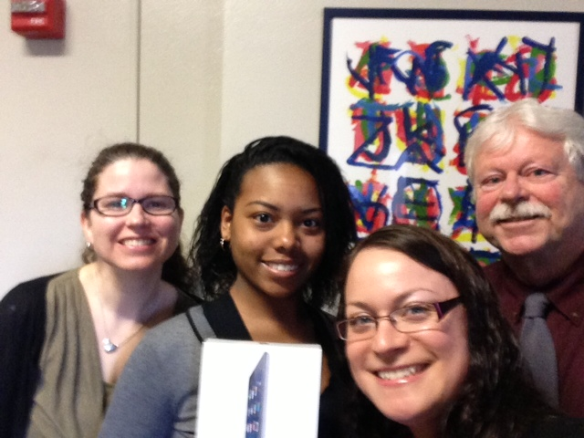
NSSE Student Incentive Winner Victoria Vanderhall
First Year Student in OIE selfie

Slide 13
Increase NSSE Assessment Data Usage
Office-led Focus Groups
Student Investigators

Slide 14
6. Upcoming Surveys
Academic Year 2014-2015
CIRP Freshman Survey – Summer 2014
NSSE – Spring 2015
Student Opinion Survey (SOS) – Spring 2015 – Stratified Random Sample of approx. 1,000 students – paper survey to selected large classes.

Slide 15
7. Website Updates
http://www.potsdam.edu/offices/ie/index.cfm
Planning and Assessment → Academic Assessment

Slide 16
Student Learning Outcomes
Assessment Reports
Reports due September 30th, 2014
  Sociology
  Philosophy
  Physics
  Politics
  Psychology
  Music Theory
  Theatre/Dance
  Music History
  Music Composition
  Music Performance
  Music Business
  Study Abroad

Slide 17

Other Business
Next Meeting tentatively scheduled for Tuesday September 23rd 3pm Location TBA

